Slide 1

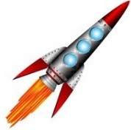
Orient for Separation
LV Separation and Checkout
Separation
Inspection Distance Checkout
Move to maximum relative separation
Launch
Stationkeep at maximum relative distance
Extended Ops and Deorbit
Repeat mission without visual aids
Inspection
Rendezvous

